Slide 1
5 quick steps process to understand what factors may drive housing prices in the city you live in
Notes:
At some point in our lives, most of us will be searching for buying a property. That could be for investment purposes, o for our own living. Own living there may be some other emotional factors, while investment is more numeric

Slide 2




When or where to choose to buy, can range from multiple factors
Location
Demographics
Real state
Macroeconomic

Slide 3


About Barcelona (demo)
1
Population and gender split
2015
2021
53%
2015
2021
52%
0.6%
CAGR
47%
48%
1605k
1660k

Slide 4

About Barcelona (demo)
1
Average household size
2015
2021
≈
2,39 pax
2,40
pax

Slide 5

About Barcelona (demo)
1
Average gross income
2015
2021
2.76%
CAGR
43,5k€
51,3k€
Inflation source Macro trends here

Slide 6
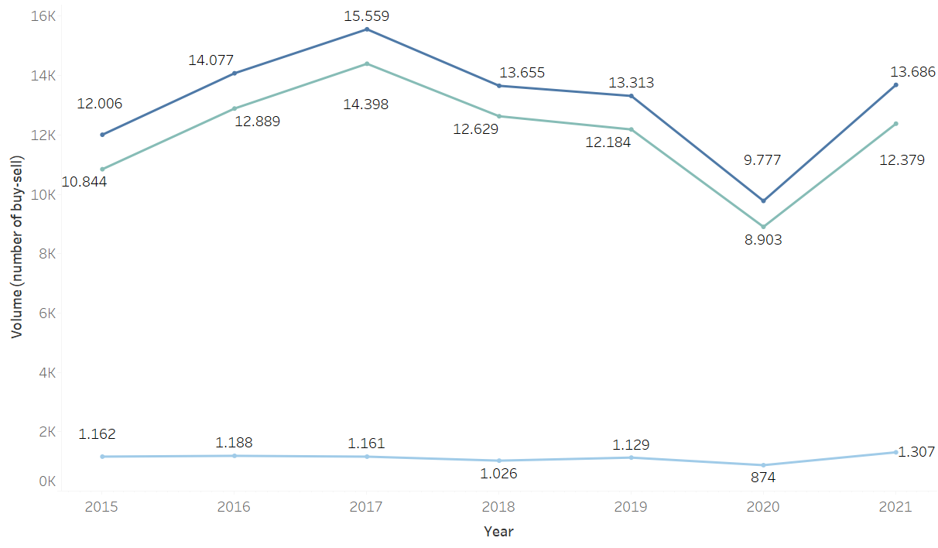
2
Volume (number of transactions)

Slide 7
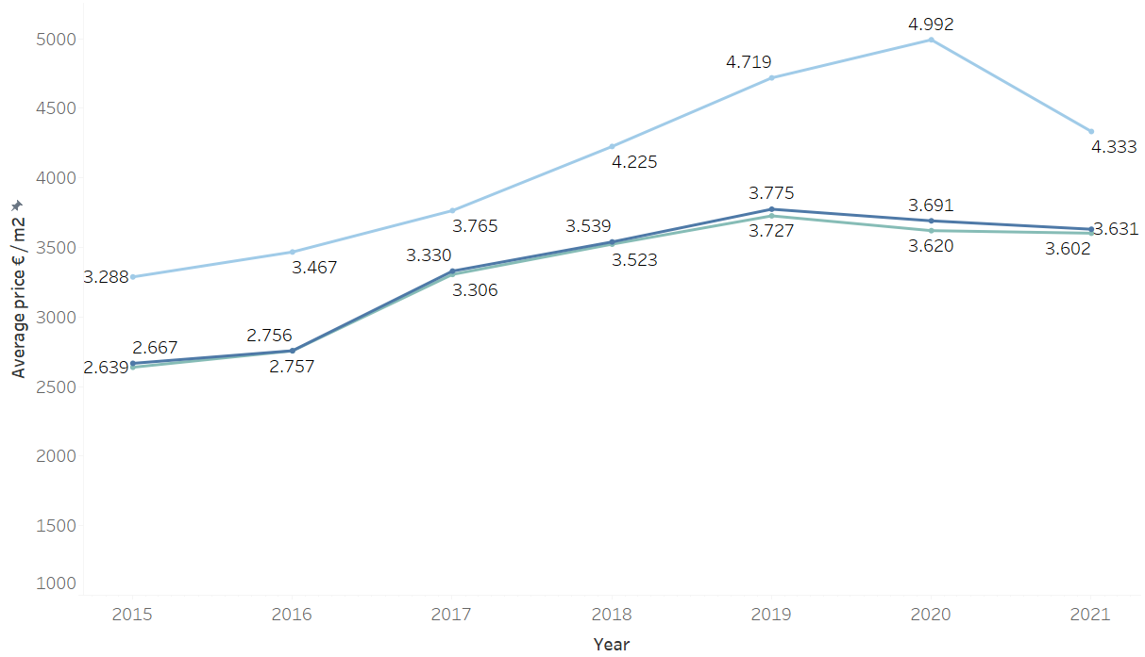
2
Average price € / m2

Slide 8
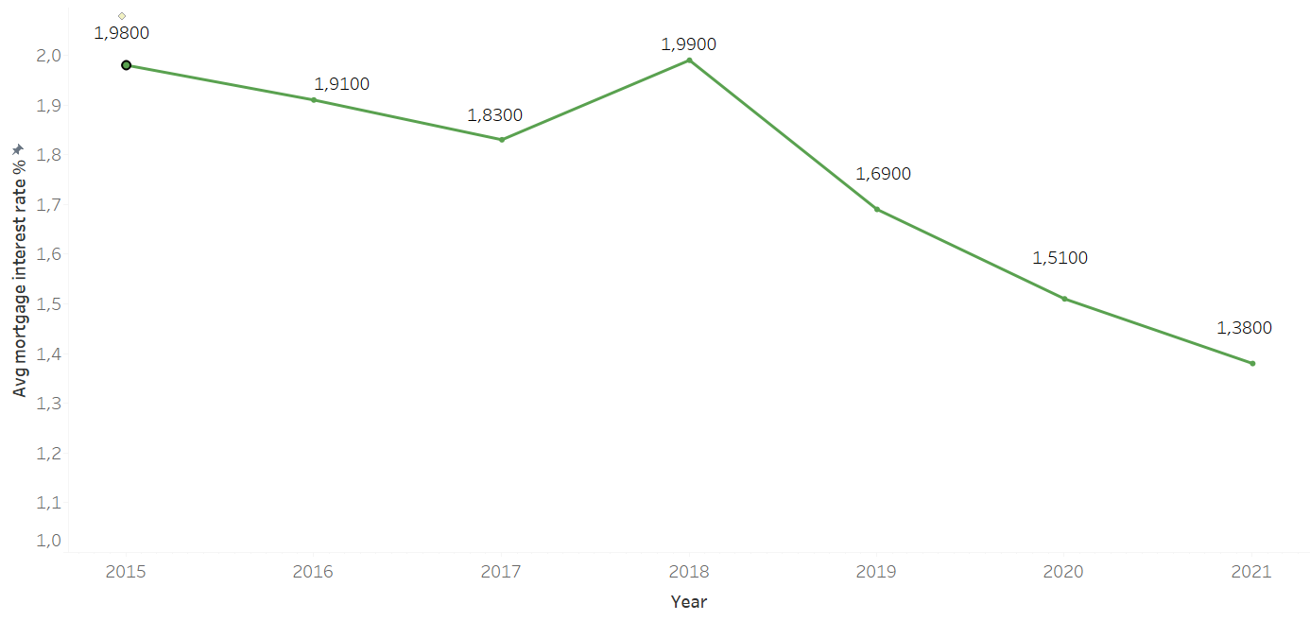
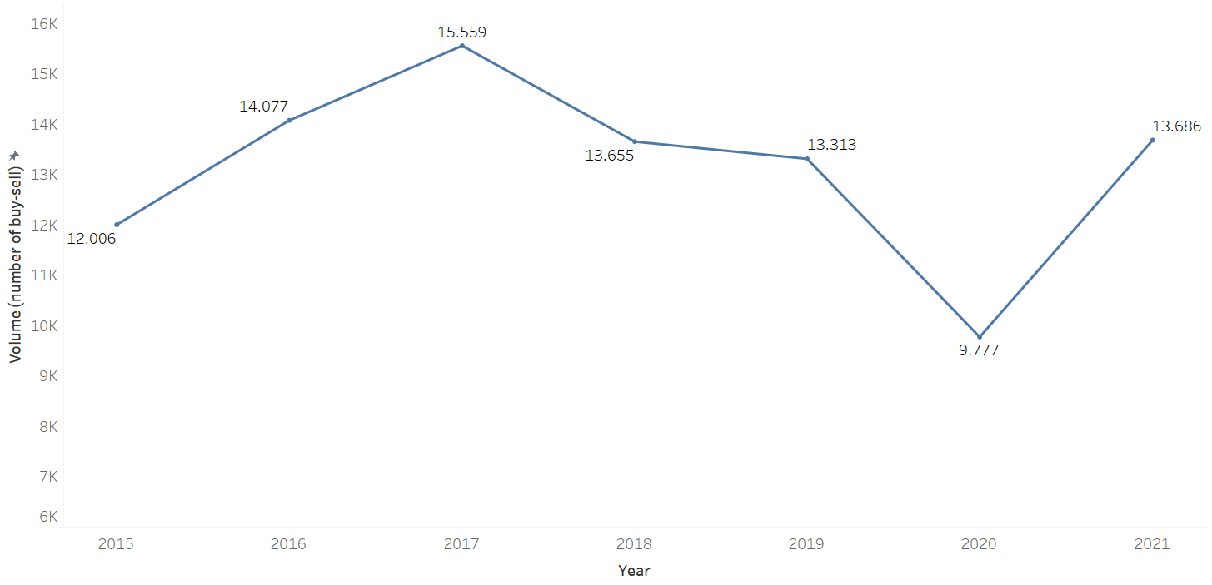
3
Average mortgage interest rate %
Historical transactions
Peak
Peak
3-year drop
3-year drop

Slide 9
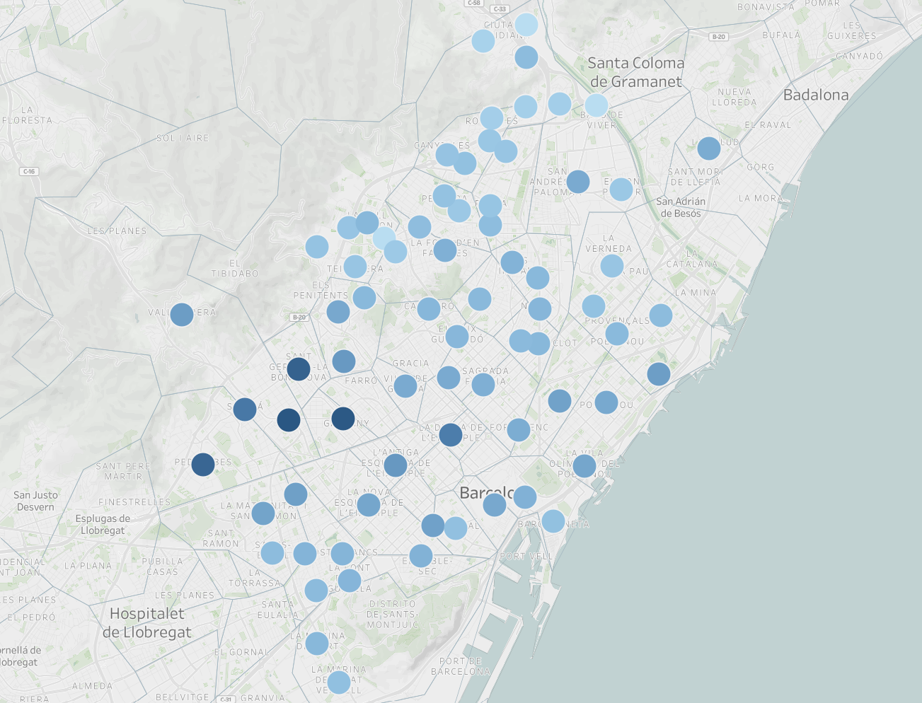
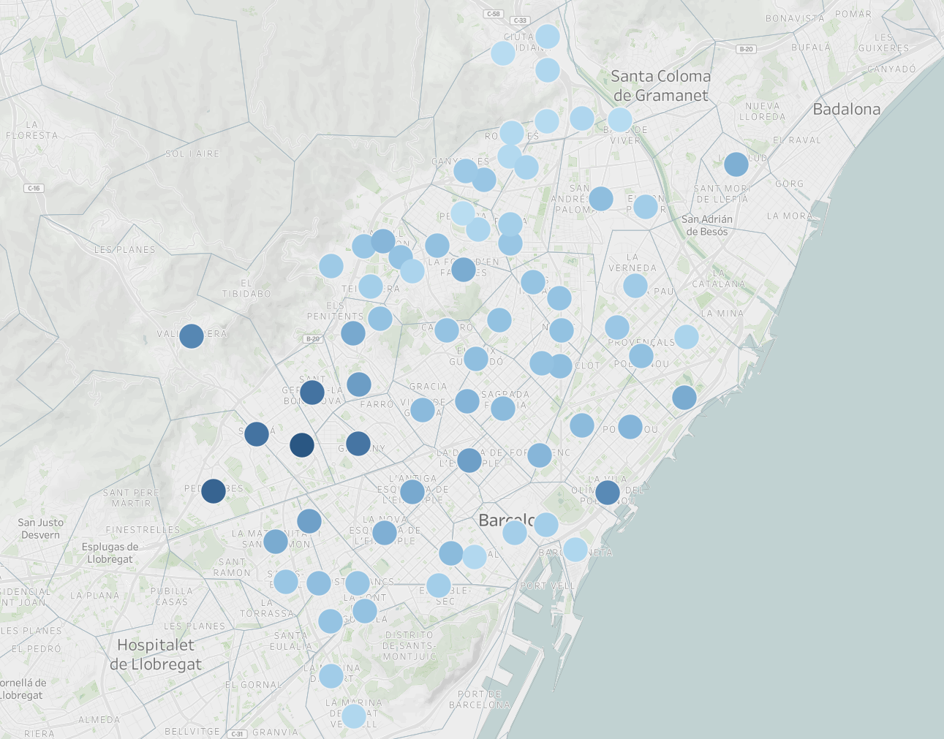


Relationship between avg gross income and avg selling price has been the highest
4
Average selling price €000 (2021)
Average gross income € (2021)
106
32k
104
107
30k
33k
849
102k
685
102k
815
921
913
113k
123k
100k
The more avg. gross income, the higher the avg selling price of homes in 2021

Slide 10
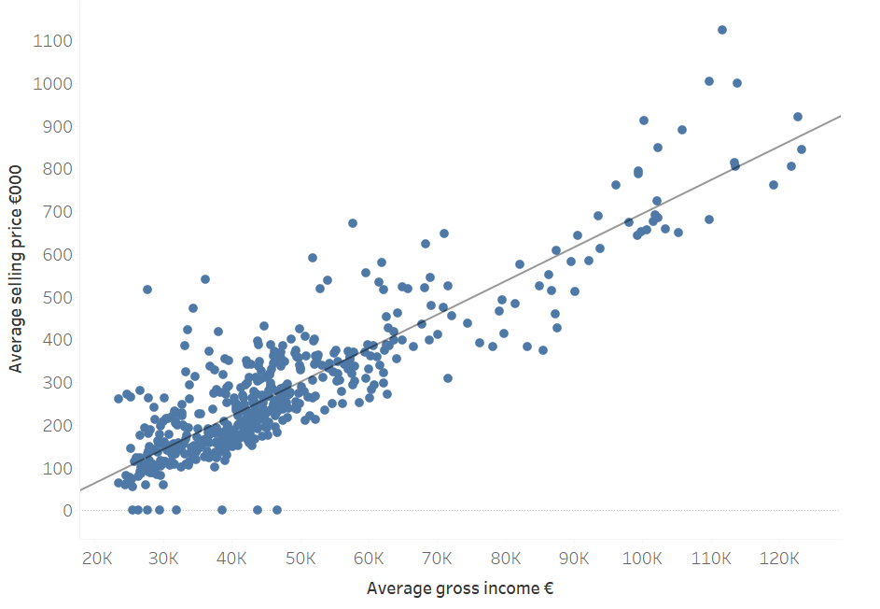
4

Slide 11
5

